Slide 1
More about Equations of Circles

Slide 2

Besides considering given points on a circle, the equation of the circle can also be found based on other given information.
In the following, let me illustrate this with examples.

Slide 3
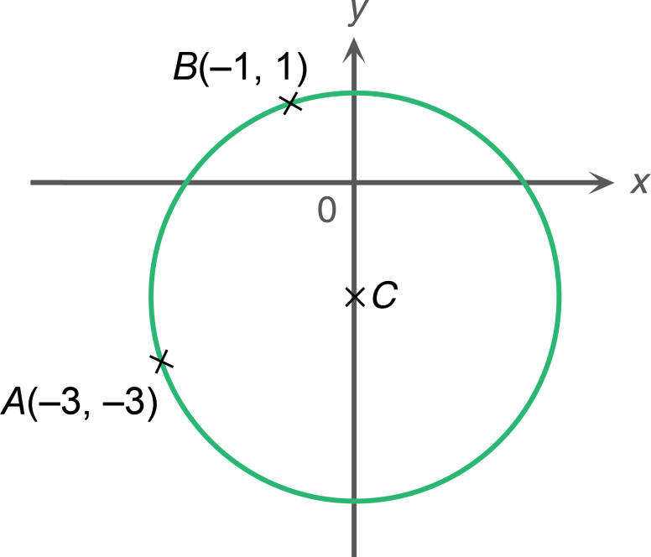

A circle with its centre lying on an axis
In the figure, the circle passes through two points A(–3, –3) and B(–1, 1). The centre C of the circle lies on the y-axis.
(a) Find the equation of the circle.
(b) Determine whether the point P(4, –1) lies on, inside or outside the circle.
In this case, we know two points on the circle and the centre of the circle lies on the y-axis. We can make use of the given conditions to find the centre and the radius of the circle.

Slide 4
A circle with its centre lying on an axis
In the figure, the circle passes through two points A(–3, –3) and B(–1, 1). The centre C of the circle lies on the y-axis.
(a) Find the equation of the circle.
(b) Determine whether the point P(4, –1) lies on, inside or outside the circle.
Since C lies on the y-axis, its x-coordinate must be 0. We can let (0, c) be the coordinates of C.

Slide 5
A circle with its centre lying on an axis
In the figure, the circle passes through two points A(–3, –3) and B(–1, 1). The centre C of the circle lies on the y-axis.
(a) Find the equation of the circle.
(b) Determine whether the point P(4, –1) lies on, inside or outside the circle.
CA and CB are two radii of the circle.
Therefore, CA = CB.
This can be used to find the
y-coordinate of C.

Slide 6
(a) Let (0, c) be the coordinates of the centre C.
∵ CA = CB (radii)
∴
∴ The coordinates of C are (0, –2).
The radius of the circle
After finding the coordinates of C, we can find the radius by the distance formula.
∴ The equation of the circle is x² + (y + 2)² = 10.

Slide 7

A circle with its centre lying on an axis
In the figure, the circle passes through two points A(–3, –3) and B(–1, 1). The centre C of the circle lies on the y-axis.
(a) Find the equation of the circle.
(b) Determine whether the point P(4, –1) lies on, inside or outside the circle.
How can we determine the position of P relative to the circle in part (b)?

Slide 8
A circle with its centre lying on an axis
In the figure, the circle passes through two points A(–3, –3) and B(–1, 1). The centre C of the circle lies on the y-axis.
(a) Find the equation of the circle.
(b) Determine whether the point P(4, –1) lies on, inside or outside the circle.
We can compare the distance between C and P with the radius r.

Slide 9
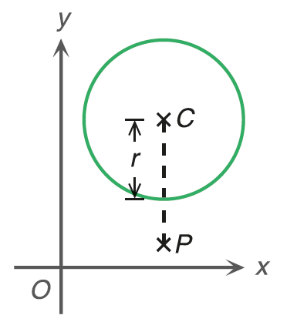
Case 1: P lies outside the circle.
CP is longer than the radius of the circle.
i.e. CP > r

Slide 10
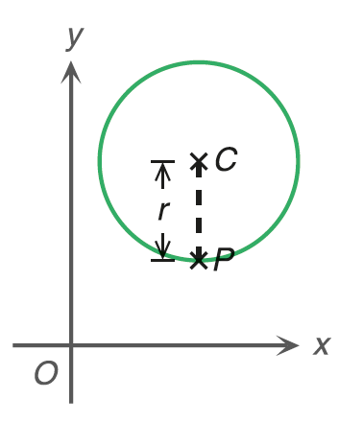
Case 2: P lies on the circle.
CP is equal to the radius of the circle.
i.e. CP = r

Slide 11
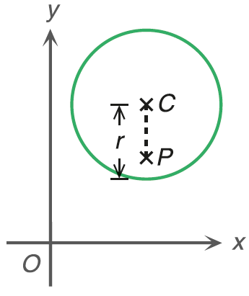
Case 3: P lies inside the circle.
CP is shorter than the radius of the circle.
i.e. CP < r

Slide 12


(b) From (a), coordinates of C = (0, –2) and radius
i.e. CP > radius
∴ P(4, –1) lies outside the circle.
P(4, –1)

Slide 13
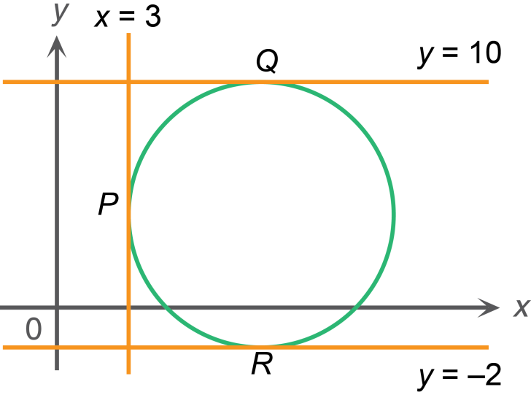
A circle touching two horizontal lines and one vertical line
In the figure, the straight lines x = 3, y = 10 and y = –2 touch the circle at P, Q and R respectively.
(a) Find the radius of the circle.
(b) Hence, find the equation of the circle.
Without the centre, I may find a diameter first. Is QR a diameter of the circle?

Slide 14

C
tangent ⊥ radius
Let C be the centre.
∵ y = 10 and y = –2 are two horizontal lines.
∴ QCR is a vertical line segment.
∴ QR is a diameter of the circle.

Slide 15
C
(a) Radius of the circle

Slide 16
C
(a, b)
3
radius
= 6
(b) Let (a, b) be the coordinates of C.
a = 3 + radius
= 3 + 6
= 9

Slide 17
radius
= 6
C
(9, b)
10
b = 10 – radius
= 10 – 6
= 4

Slide 18
radius = 6
C
(9, 4)
∴ The centre is C(9, 4).
∴ The equation of the circle is
(x – 9)² + (y – 4)² = 36

Slide 19
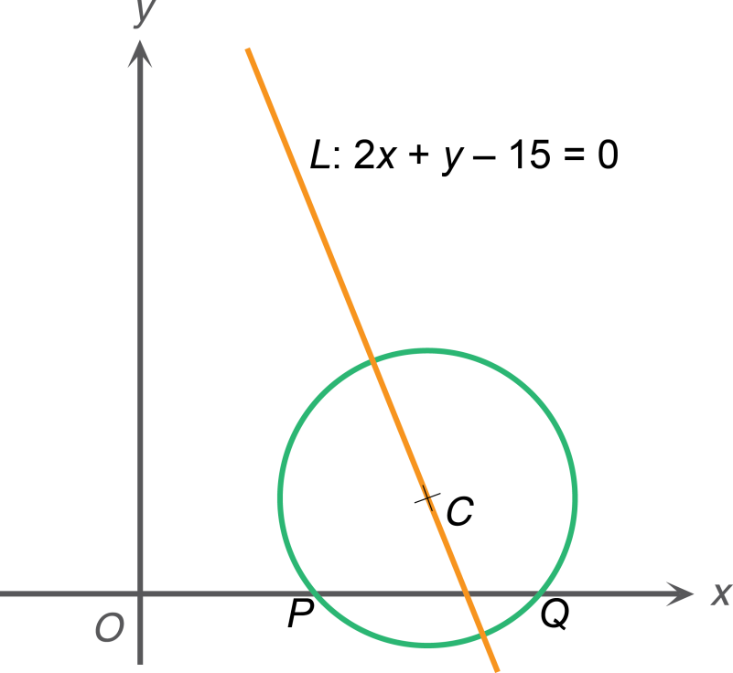

A circle with its centre lying on a given straight line
In the figure, the circle cuts the x-axis at two points P and Q. Its centre C lies on the straight line L: 2x + y – 15 = 0. It is given that the radius of the circle is and PQ = 4. Find (a) the centre of the circle, (b) the equation of the circle.
How can I use the given information to find the coordinates of C?

Slide 20
Let (h, k) be the coordinates of C and M be the mid-point of PQ.
The length of CM is the y-coordinate of C.
M
M is the mid-point of PQ,
PQ⊥CM.

Slide 21
Let (h, k) be the coordinates of C and M be the mid-point of PQ.
The lengths of CP and PM are known. The length of CM can be found by Pyth. Theorem.
△CMP is a right-angled triangle.
M

Slide 22
Let (h, k) be the coordinates of C and M be the mid-point of PQ.
∵ PM = QM
∴ CM⊥PQ (line joining centre to mid-pt. of chord⊥chord)
Consider △CMP.
M
i.e. k = 1

Slide 23
Note that the centre C lies on the straight line L. If the x-coordinate or the y-coordinate of C is known, the other coordinate of C can be found.

Slide 24
∵ C(h, 1) lies on the straight line L: 2x + y – 15 = 0.
∴ 2h + 1 – 15 = 0
h = 7
∴ The centre of the circle is (7, 1).
(b) The equation of the circle is

